Slide 1
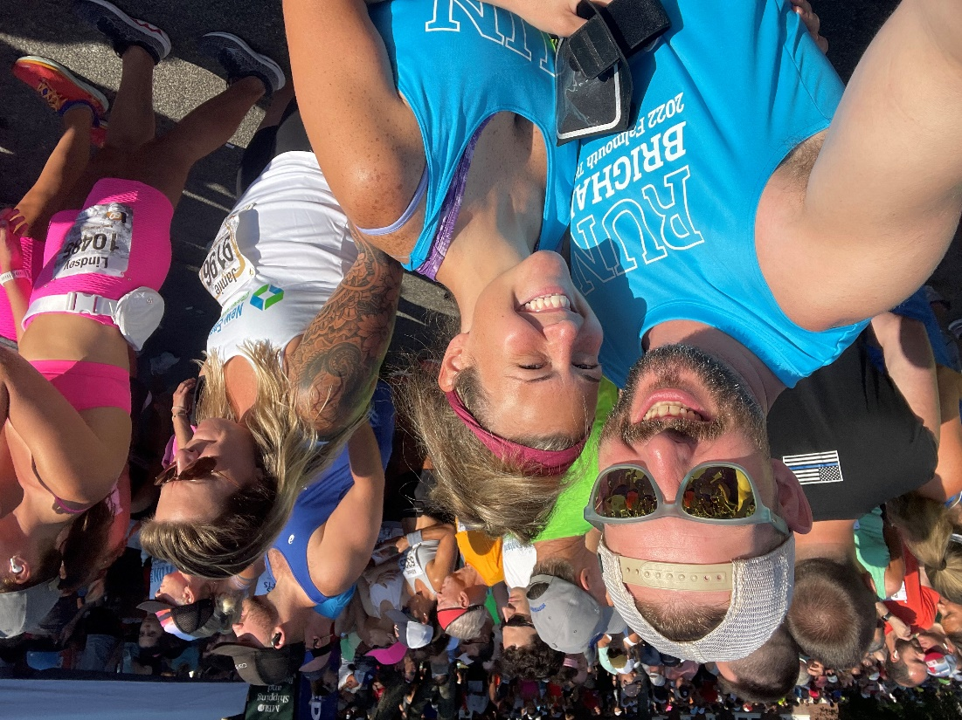
SUPPORT MY FALMOUTH ROAD RACE!
Help me raise money to support the (insert fund name) at the Brigham!
Event: Falmouth Road Race
Date: August 20, 2023
Donate here:
(insert link to fundraising page)
Select “Donate”
ADD YOUR PICTURE
Questions? Contact (insert name) at (insert email).

